Slide 1

Chess Royale
Software Engineering
ITSC-3155
Final Project Presentation An Huynh, Austin Lamp, Carson Goins, Simran Bolla

Slide 2
Table of Contents
This presentation is intended to cover:
The purpose of this project.
The scope and objectives.
The context diagram, dataflow diagram, use-case diagram, use-case templates.
Images of working project and interfaces.
Discussion.
Conclusion.

Slide 3
Introduction
This project was created in order to demonstrate mastery of skills needed to develop software, learn and practice the skills learned throughout our Software Engineering course this semester.
In order to demonstrate our skills, we have recreated the original idea of chess and added features in order to enhance the complexity of the game. We have added these changes as our goal was to create more interest and a larger audience for the game.
We added a useful User Interface to navigate the game, save game data, and included information related to the players (movements made, winner, etc.)

Slide 4
Purpose
The purpose of this project was to create a chess game that would appeal to a larger audience through unique game features and additional pieces, in order to promote playability.
The goal was to focus on implementing game features rather than focusing on the game engine, so we used the Unity game engine to build our project.
By enhancing complexity and features, our goal was to continue the growth of the classic chess game, and encourage new ideas for great features for the future.

Slide 5
Scope and Objectives
To develop the graphics to be used within our game.
To develop the main menu and create necessary interactions to move throughout the system.
To develop the original game of chess.
To use the goal we have in mind of providing uniqueness to the game, and develop new features to add on to the original game of chess.
To randomize the game of chess.
To customize the game of chess.
To mock database to record saved moves.
To test code using unit test and application testing.

Slide 6
Project Definitions, Acronyms, Abbreviations
Unity - Refers to Unity Editor, Hub, and Game Engine, collectively.
These are the tools that were created by Microsoft for the creation of games and were all used in the creation of the project, for collaboration and libraries/features.

Slide 7
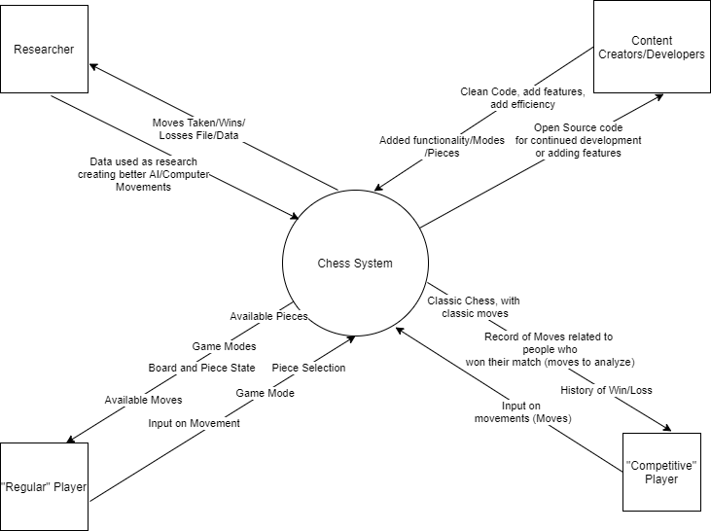
Context Diagram

Slide 8
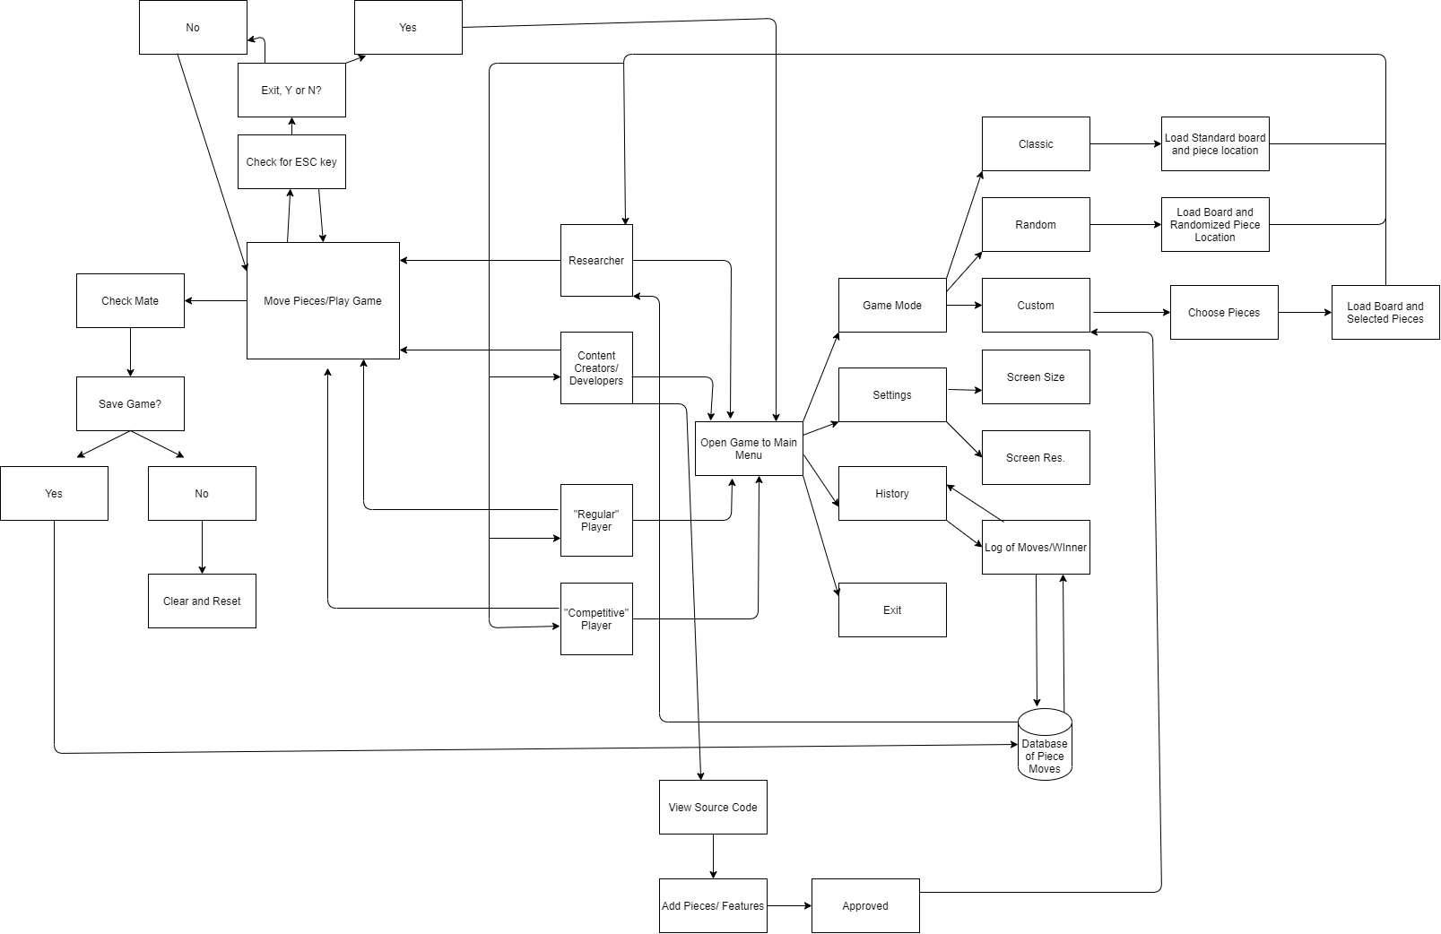
DFD Diagram

Slide 9
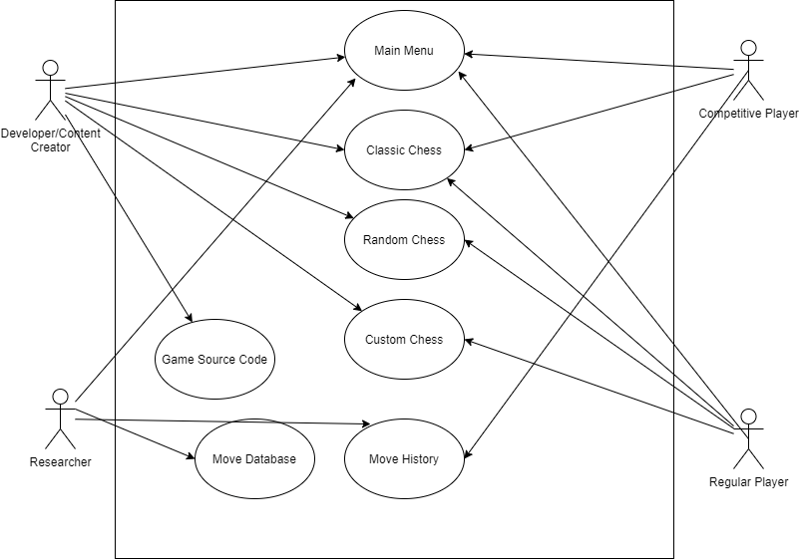
Use-Case Diagram

Slide 10
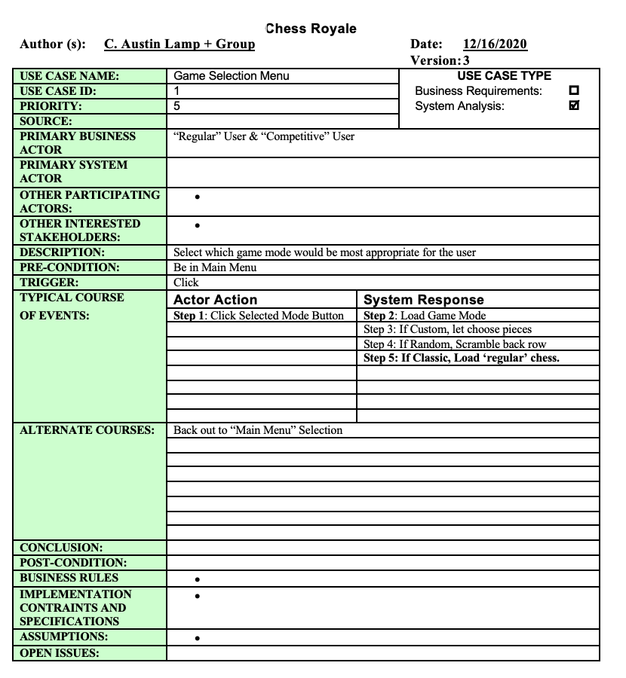
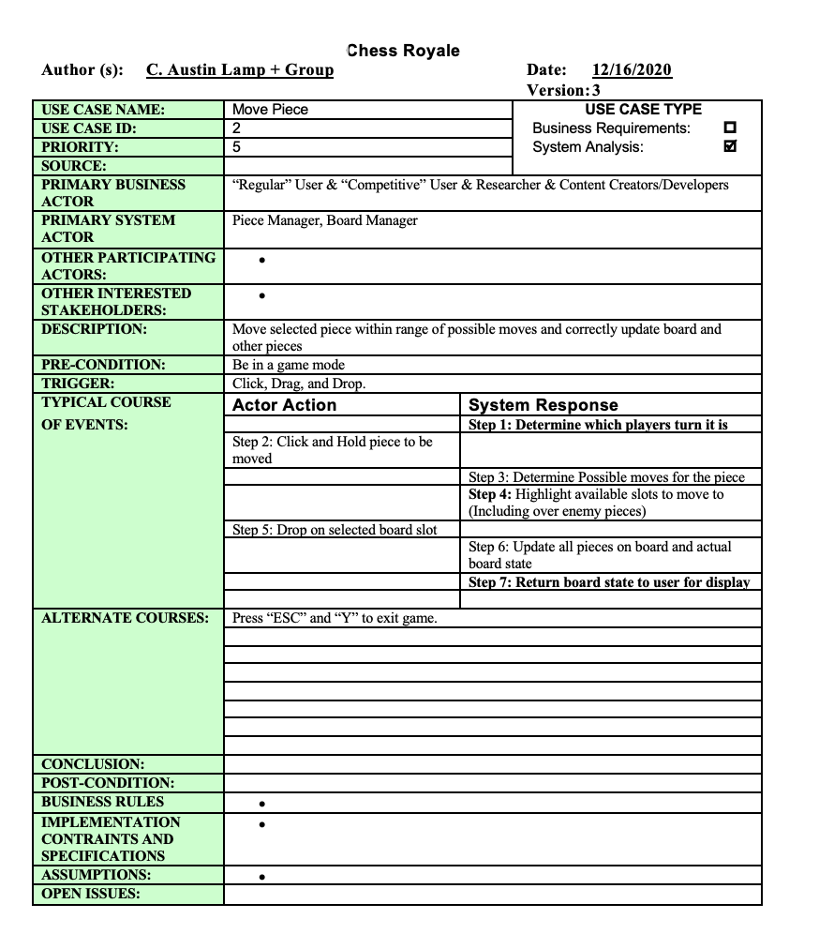
Use-Case Templates

Slide 11
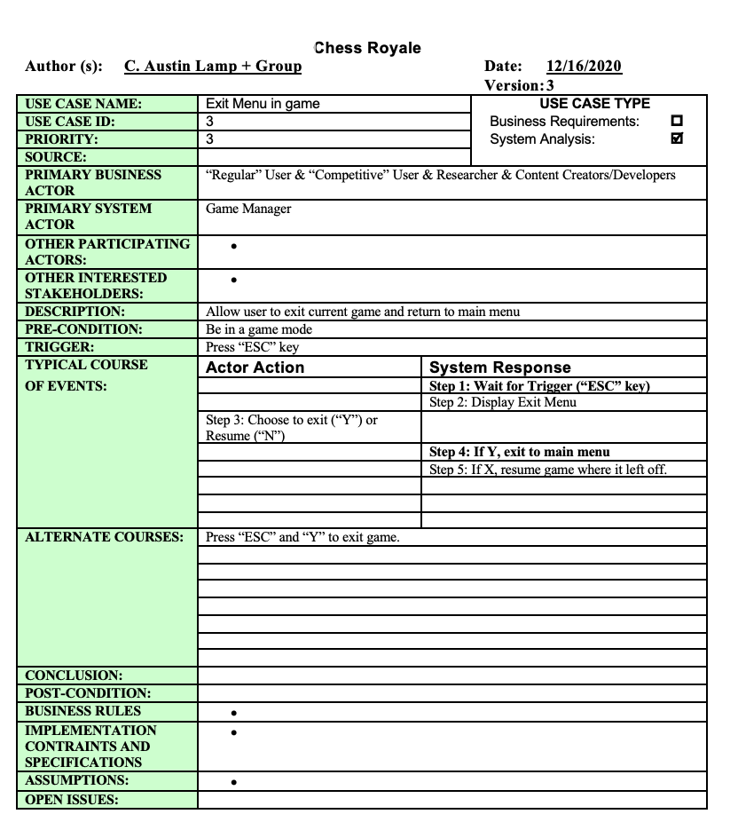
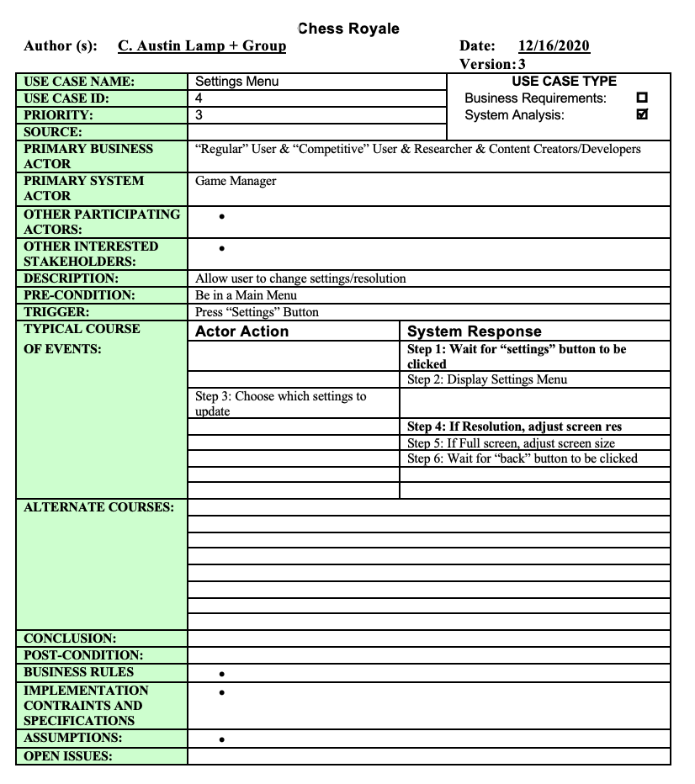

Slide 12
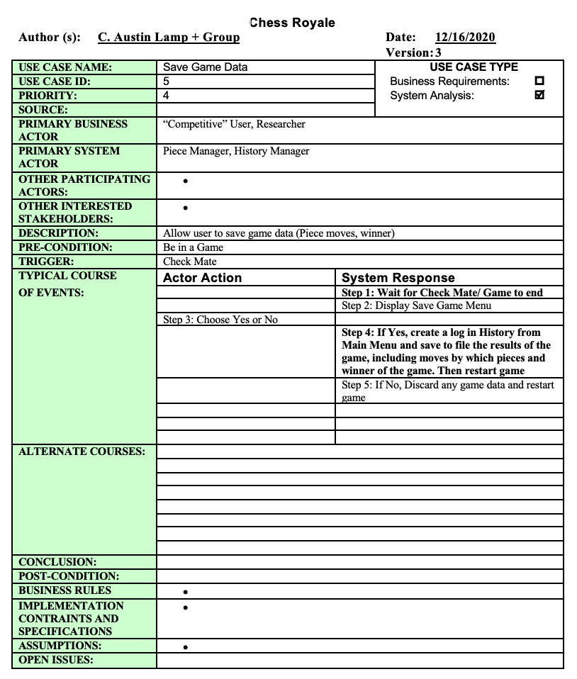
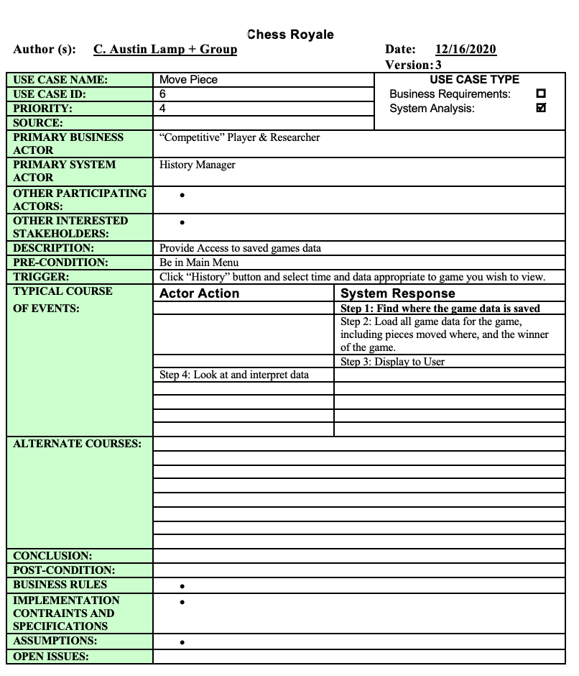

Slide 13
Overview of Program
This program contains a User Interface for a ‘Main Menu’, which leads either into a game mode, a movement history section, a setting menu UI, or an exit menu.
Unity Game Engine and C# was utilized by the group.
Agile methodology, Software Engineering standards, and Software System modeling was practiced through this project.

Slide 14
Screenshots of User Interfaces

Slide 15
Screenshots of Working Project

Slide 16
Screenshots

Slide 17
Discussion
The biggest challenge for us during this project was the testing portion.
At times, our project was not testable through unit testing since much of it was based on interaction, specifically through UI.
To overcome this challenge, we tested several things through UI interactions, constantly checked for bugs within the interactions between pieces and checked for the appropriate outputs in our database.
Additional hurdles includes creating the logic of the game, implementing extra game modes, and building the database.

Slide 18
Discussion
Continued
Nonetheless, through this project, we had the opportunity to gain hands-on experience using the Unity Game Engine in order to develop a UI and create scripts that could create a functioning game.
We also gained some experience in databases.
We also learned the importance of working as a team, effectively communicating.

Slide 19
Conclusion
This concludes our Software Engineering
Chess project presentation.
Thank you for your time.

